Slide 1
Micron-VE
External
NPI Applications Team
1 March, 2024
Rev 1 : 7 March, 2024

Slide 2
Outline
-- Consolidated Flowsheet
- HFW pretreatment & concentration (RO₁)
- HFW reject & LSR reject blending
- Jar Tests (SCE-1)
- RO₂
- Jar Tests (SCE-2)
- CFRO
- Crystallizer
Notes:
-Experimental Results, Model Data, Learnings (The bulk of the presentation)

Slide 3
NaOH, Fe₂(SO₄)₃
CONSOLIDATED FLOWSHEET
Na Silicate
SCE-1 supernatant (5)
SCE-1 Feed (4)
SCE-1
LSR reject (3) ~ 225L
NaF, NH4OH & H₂SO₄ dosed
CFRO permeate
Mix tank 1
H₂SO₄ (Feed pH 6.5-7.2)
Pass 2 permeate
NaOH, Fe₂(SO₄)₃
Crystallizer
NaOH (pH 6.5-7.2)
RO₂ pass 2
SCE-2
UF2
CFRO Feed (9)
HFW A1
SCE-2 supernatant (8)
CFRO
NaF & Nitrate as salts
UF1
RO₁
RO₂ feed (6) ~ 450 L
RO₂
H₂SO₄
(Feed pH 6.5 - 7.2)
HFW A2
RO₁ Inlet (1) ~ 1800L
RO₁ reject (2) ~ 225L
86.7% rec
RO2 reject (7) ~ 32 L
93% rec
CFRO reject (10)
62% rec
Stream | 1 | 2 | 3 | 4 | 5 | 6 | 7 | 8 | 9 | 10
 | RO1 inlet | RO1 reject | LSR reject | SCE-1 feed | SCE-1 supernatant* | RO2 feed | RO2 reject | SCE-2 supernatant* | CFRO feed | CFRO reject
pH | 6.57 | 7.14 | 7.38 | 8.92 | 8.83 | 6.93 | 7.64 | 8.8 | 7.19 | 8.23
TDS, mg/L | 1373 | 7,154 | 428 | 5,098 | 4,410 | 5,188 | 66,800 | 62,928 | 64,520 | 169,440
Fe, mg/L | 0.112 | < 0.1 | 0.238 | <1 | 50.4 | <1 | 5.5 | 453 | 2.15 | 10.1
Silica, mg/L | 12.4 | 80.4 | 56 | 115 | 81.5 | 61.4 | 396 | 172 | 159 | 269.5
Na, mg/L | 484 | 3,168 | 158 | 2,250 | 1,937 | 2,265 | 29,580 | 26,900 | 23,560 | 61,720
F, mg/L | 358 | 1,689 | 197 | 1,341 | 1,189 | 1,527 | 17,359 | 18887 | 16,691 | 24,722
Cl, mg/L | 25.1 | 281 | 55.3 | 174 | 179 | 180 | 2,347 | 2,433 | 2,274 | 11,284
PO4, mg/L | 15.7 | 77.1 | <1 | 45.8 | 12.6 | 47.5 | 609 | 512 | 585 | 3,193
SO4, mg/L | 5.84 | 33.3 | 6.11 | 150 | 595 | 161 | 1,950 | 3,479 | 4,946 | 30,152
NO3, mg/L | 230 | 1,323 | 13.5 | 730 | 844 | 829 | 9,351 | 8,670 | 9637 | 24,761
* SCE-1&2 supernatant:- During the test, Fe₂(SO₄)₃ at pH 8.5 was used, increasing pH above 9.3 helps with better silica removal and less Fe carryover (refer to SCE-2 Jar Test data).
Notes:
HFW Reject Fluoride=1658 mg/l. TDS is not consistent with slide 11 == TDS value changed to gravimetric!
Move label for Stream 4 to after the dosing point. It isn’t clear if that stream is before or after dosing == done
Is there an analysis for stream 4? == yes, SCE-1 feed
There is no stream between SBRO and SCE-2 == SBRO reject is to be treated using SCE-2
You should take out LSR process unit block, and just start with LSR reject stream. == done
Switch the Mix~450L as a tank. Then draw a line with chemical dosing == done
Draw stream 4 as a dotted line. To indicate it is not part of the normal process design == done
Show chemical addition as a different line == done
Should be using gravimetric TDS
Check all water parameters

Slide 4
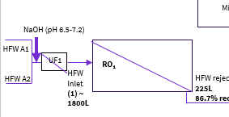
HFW Pretreatment & Concentration
Notes:
-Experimental Results, Model Data, Learnings (The bulk of the presentation)

Slide 5
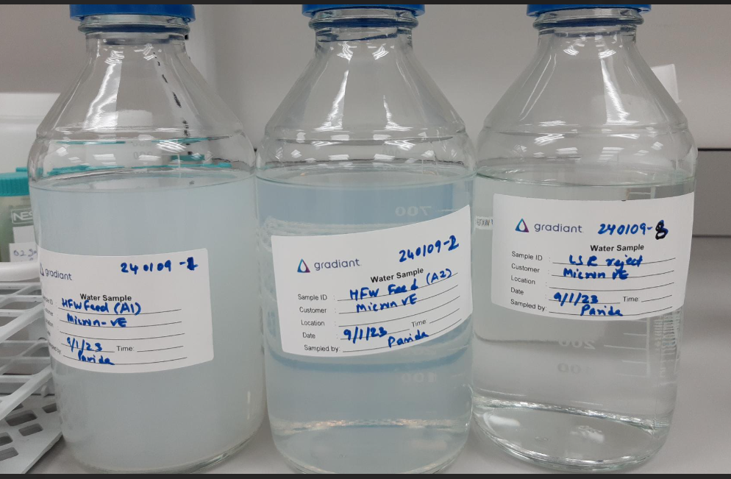
HFW Feed & LSR reject
Objective:- HFW to be suitably pretreated and reconcentrated using RO.
3 samples received
HFW from A1,
HFW from A2 &
LSR reject
Notes:
-Experimental Results, Model Data, Learnings (The bulk of the presentation)

Slide 6
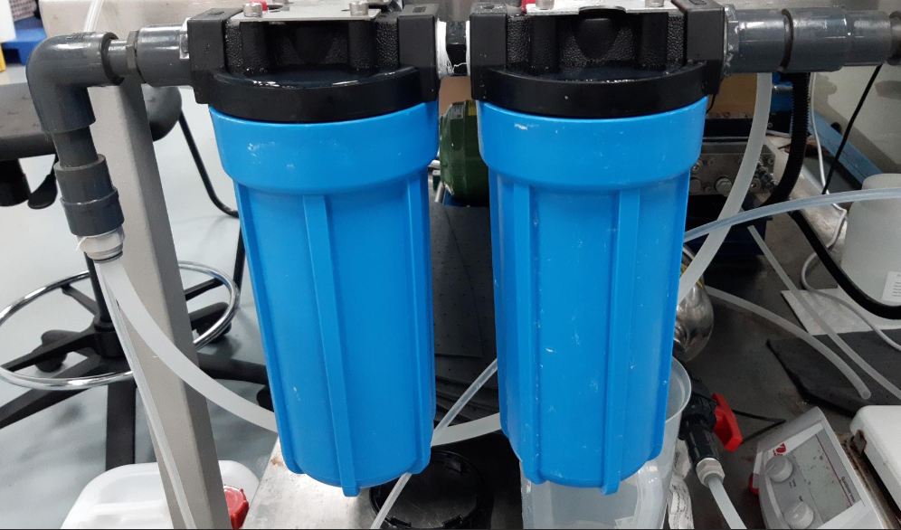
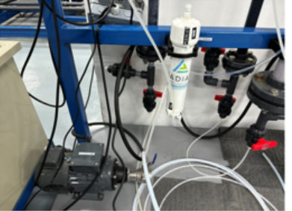
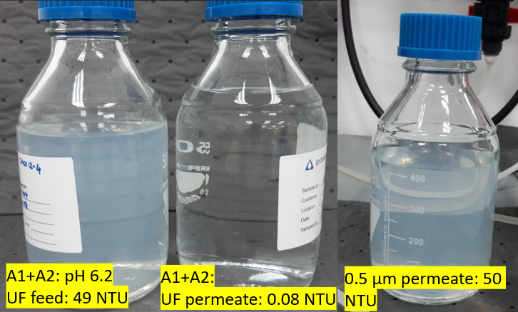
HFW Pretreatment
Parameter | HFW Feed (A1) | HFW Feed (A2)
pH | 2.94 | 3.23
TDS, mg/L | 756 | 14
SiO₂ (mg/L) | 17.4 | 8.19
Na (mg/L) | 187 | 7.67
F (mg/L) | 462 | 130
Cl (mg/L) | 23.2 | 13.8
PO₄ (mg/L) | 28.4 | 4.21
SO₄ (mg/L) | 4.76 | 7.41
NO₃ (mg/L) | 742 | 4.34
NH₄ (mg/L) | 10 | 10.4
Turbidity (NTU) | 255 | 64.3
TSS (mg/L) | 81 | 16
Blended equal volumes of HFW A1 and A2.
HFW Turbidity and TSS is high and needed pretreatment.
0.5-µm cartridge followed by 0.01 µm-UF were used for turbidity reduction.
UF is effective in turbidity removal (colloidal content in the sample is too fine to be removed by cartridge filter).
0.5-µm cartridge
UF

Slide 7
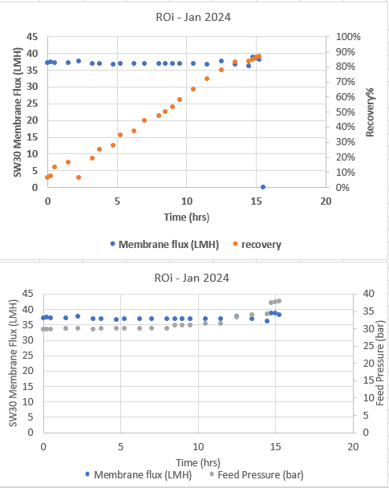
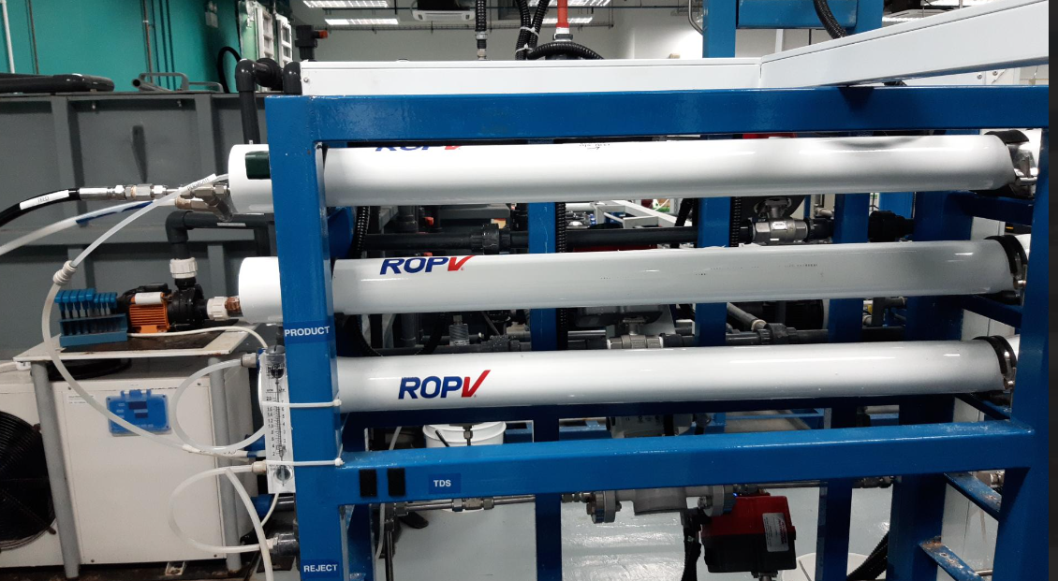
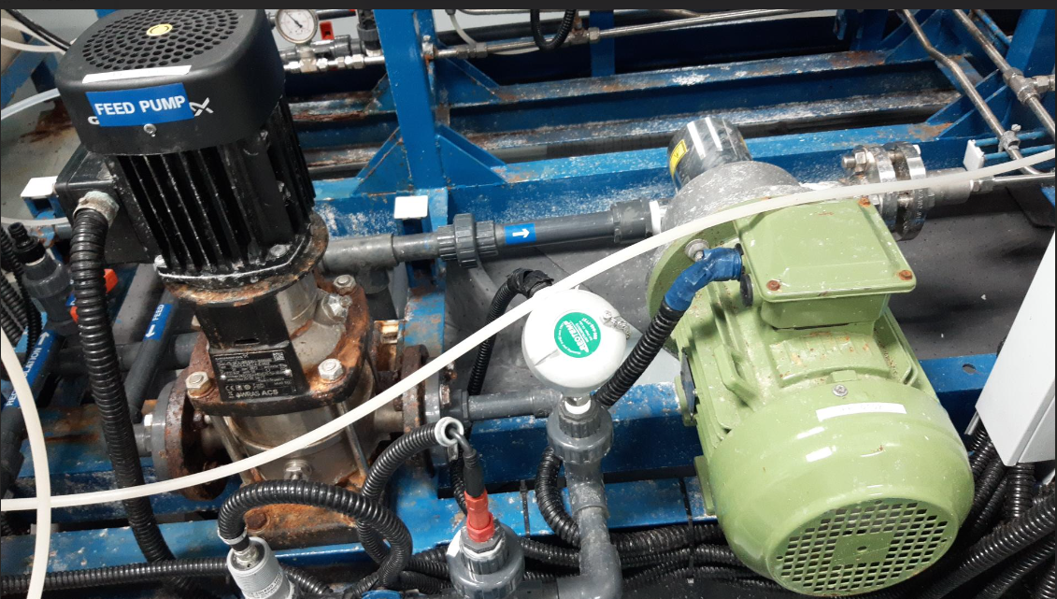
RO₁
Objective:- HFW feed stream is to be concentrated using the pressurized RO setup
Feed pressure: upto 1000 psi (69 bar); Flow ~ 6 lpm; Concentrated ~ 1800 L of feed into ~ 250 L
( ~ 86% recovery; 7x concentration)
Pressure vessel
High-pressure pump
Parameter | RO1 Inlet | RO1 Reject
pH | 6.57 | 7.14
TDS, mg/L | 1373 | 7154
SiO₂ (mg/L) | 12.4 | 80.4
Na (mg/L) | 484 | 3168
F (mg/L) | 358 | 1689
Cl (mg/L) | 25.1 | 281
PO₄ (mg/L) | 15.7 | 77.1
SO₄ (mg/L) | 5.84 | 33.3
NO₃ (mg/L) | 230 | 1323
NH₄ (mg/L) | 7.2 | 37
Notes:
This is HFW + LSR stream

Slide 8
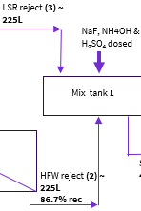
HFW reject and LSR reject Blending
Notes:
-Experimental Results, Model Data, Learnings (The bulk of the presentation)

Slide 9
Mixing Tank blending
Parameter | HFW reject | LSR Reject | Blend | Spike NaF+NH4OH to match design => SBRO feed
pH | 7.14 | 7.38 | 7.1 | 6.93
TDS, mg/L | 7154 | 428 | 3878 | 5188
SiO₂ (mg/L) | 80.4 | 56 | 72.7 | 61.4
Na (mg/L) | 3168 | 158 | 1722 | 2265
F (mg/L) | 1689 | 197 | 963 →~1365 (design) | 1527
Cl (mg/L) | 281 | 55.3 | 164 | 180
PO₄ (mg/L) | 77.1 | <1 | 42.4 | 47.5
SO₄ (mg/L) | 33.3 | 6.11 | 19 | 161
NO₃ (mg/L) | 1323 | 13.5 | 649 | 829
NH₄ (mg/L) | 37 | 111 | 53 →~ 109 (design) | 80
Blended the HFW reject with LSR reject suitably to obtain ~ 1366 ppm Fluoride & NH₄ ~ 109 ppm as per design.

Slide 10
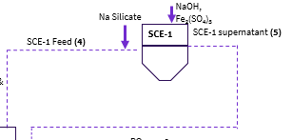
SCE -1 (Jar Tests)
Conducted offline
Notes:
-Experimental Results, Model Data, Learnings (The bulk of the presentation)

Slide 11
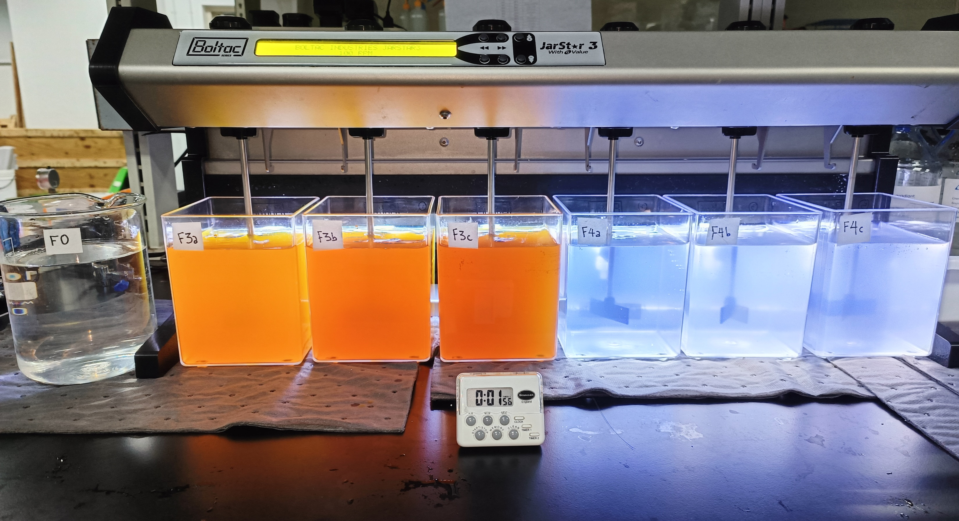
Jar Test Objective
To conduct Jar tests to determine optimal SiO₂ reduction (≤20 mg/L for SCE-1) and (≤30 mg/L for SCE-2) to meet downstream process quality requirements.
SCE-1 details:
Feed: Blended LSR & HFW RO reject streams; with SiO₂ adjusted to 140 mg/L (as per design requirement)
Coagulant: FeCl₃ (pH8.5-9.0);
Fe₂(SO₄)₃ (pH8.5-9.0)➔
(pH > 9.3) (preferable range) FeSO₄ (pH8.5-9.0); MgCl₂ (pH 10.5-11.0); MgSO₄ (pH 10.5-11.0)
Polymer: 1 ppm
Mixing Regime
Coagulant mixing: 200-rpm for 1 min → 100-rpm for 30 min
Polymer mixing: 30-rpm for 15 min
Settling: 0-rpm for 30 min

Slide 12
SCE-1 Jar Tests Summary
Coagulant | Fe₂(SO₄)₃ | FeCl₃ | MgSO₄ | MgCl₂ | FeSO₄
Dosages tested, mg/L | 750; 1,000; 1,250; 1,505; 2,005 | 610; 815; 1,220 | 1,040; 1,390; 1,735 | 825; 1,100; 1,370 | 570; 760; 950; 1,140; 1,525
Total Silica, mg/L Feed Supernatant | 115 48 - 137 | 115 13.8 - 46 | 125 35.5 - 75.1 | 125 45.1 - 78.7 | 120.9 13.0 – 42.4
Best Cases | 58.3% reduction 2,005 mg/L (pH8.8) => based on SCE-2 trials, pH > 9.3 are effective | 88.0% reduction 1,220 mg/L (pH8.8) | 71.6% reduction 1,735 mg/L (pH11.0) | 63.9% reduction 1,370 mg/L (pH11.0) | 89.2% reduction 1,525 mg/L (pH8.8)
Remarks | Unsatisfactory performance; difficulty in solubilizing coagulant, forming slurry < use liquid coagulant instead of powder > | Better performance, but added Cl to supernatant | Unsatisfactory performance, didn’t pursue further | Unsatisfactory performance, didn’t pursue further | Best performance, forming clearest supernatants
FeSO₄ is picked as the most suitable coagulant/ Fe₂(SO₄)₃ may be tried at higher pH.

Slide 13
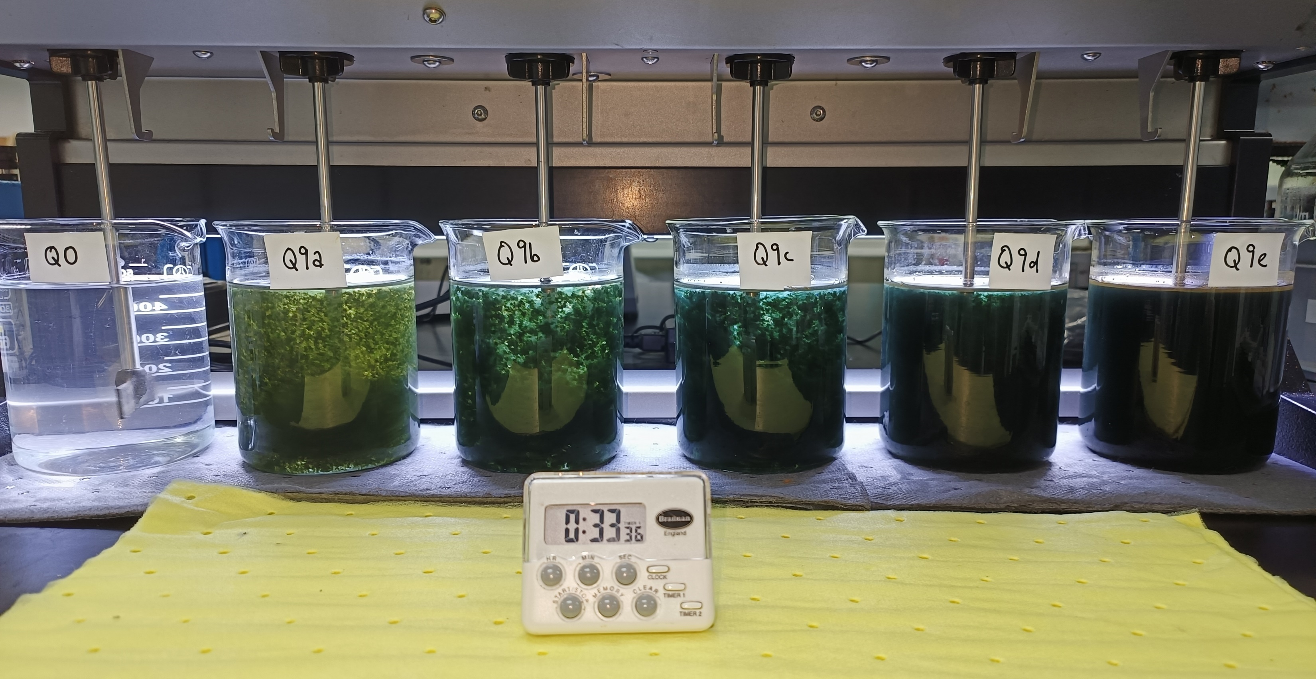
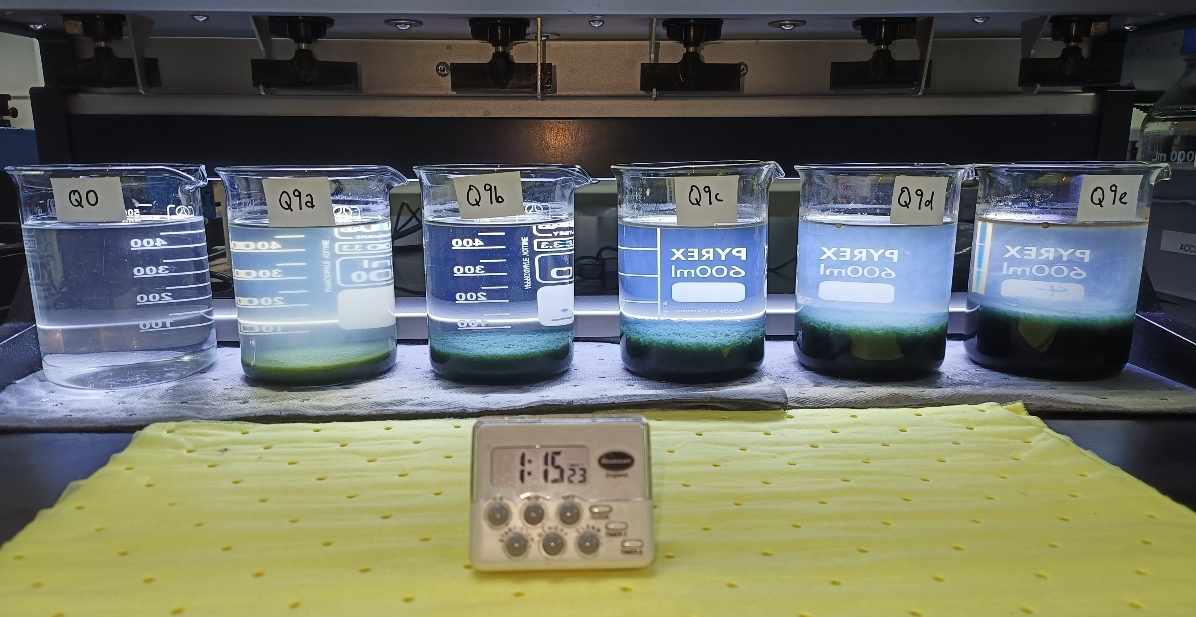
SCE-1 Jar Test with FeSO4 solution
After polymer addition
After 30-min settling
Notes:
Fix title == done

Slide 14
SCE-1 Jar Test with FeSO4 solution <analysis>
 | 1) SCE-1 Feed | 2) FeSO4 570mg/L | 3) FeSO4 760mg/L | 4) FeSO4 950mg/L | 5) FeSO4 1,140mg/L | 6) FeSO4 1,525mg/L
pH | 8.72 | 8.49 | 8.53 | 8.48 | 8.46 | 8.2
Total Silica, mg/L | 120.9 | 42.4 | 26.1 | 22.7 | 16.4 | 13.0
Dissolved Silica, mg/L | 101.5 | 34.3 | 24.8 | 19.5 | 14.3 | 10.2
Conductivity, μS/cm | 8,920 | 8,990 | 9,660 | 9,860 | 10,060 | 10,240
TDS, mg/L | 4,876 | 5,137 | 5,335 | 5,408 | 5,523 | 5,716
Na, mg/L | 2,227 | 2,529 | 2,446 | 2,284 | 2,594 | 2,616
Fe, mg/L | <1 | 6.77 | <1 | 2.16 | 5.25 | 9.77
Cl, mg/L | 174.25 | 172.78 | 172.15 | 173.5 | 372.14 | 173.34
SO4, mg/L | 150.54 | 515.11 | 621.56 | 756.3 | 854.69 | 1,113.5
Based on supernatant clarity, silica removal (upto~ 20 ppm), and residual Fe, FeSO₄ 760 mg/L is chosen.
Tackling Fe carryover in downstream processes - (if Fe > 1 ppm, filter through CF at pH ≥8.8)
Notes:
SCE Control -> Feed

Slide 15
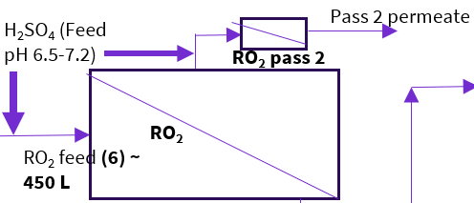
RO₂
Notes:
-Experimental Results, Model Data, Learnings (The bulk of the presentation)

Slide 16
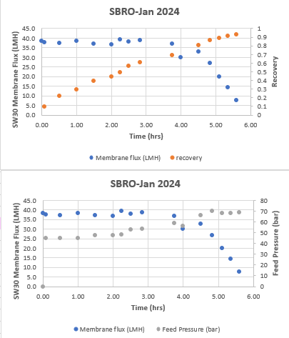
Experimental Setup
Objective:- (HFW+LSR) reject stream feed stream is to be concentrated using the pressurized RO setup
Feed pressure: upto 1000 psi (69 bar)
Flow ~ 6 lpm
Concentrated ~ 450 L of feed into ~ 32 L ( ~ 93% recovery; 14x concentration)
Pressure vessel
High-pressure pump
RO₂ Second pass
Feed pressure: upto 10 bar
Flow ~ 3.5 lpm

Slide 17
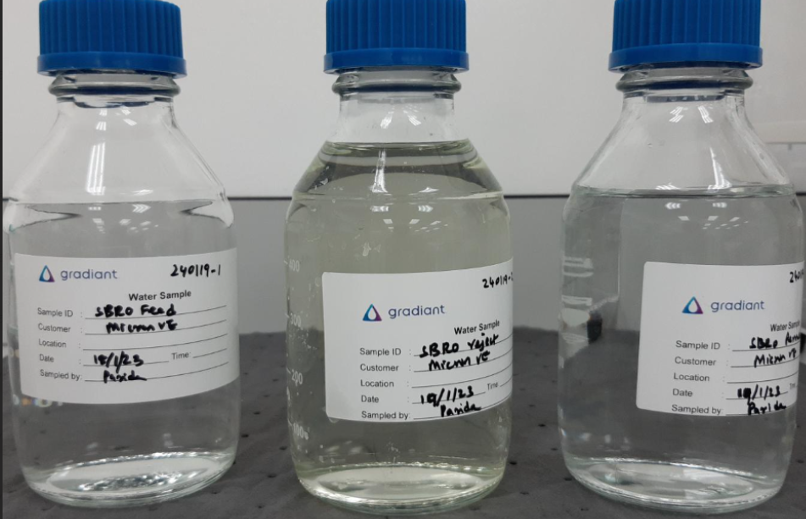
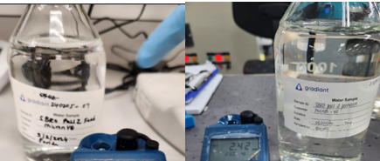
RO₂ – First & Second Pass - Analysis
Parameter | RO2 feed | RO2 reject (~ 93% recovery) | RO2 permeate (1st pass) | RO2 permeate (2nd pass)
pH | 6.93 | 7.64 | 7.23 | 6.47
TDS, mg/L | 5188 | 66800 | 40 | 3
SiO₂ (mg/L) | 61.4 | 396 | < 0.2 | < 0.2
Na (mg/L) | 2265 | 29580 | 6.4 | 1.13
F (mg/L) | 1527 | 17359 | 4.18 | 0.412
Cl (mg/L) | 180 | 2347 | 1.45 | 1.17
PO₄ (mg/L) | 47.5 | 609 | < 0.1 | < 0.1
SO₄ (mg/L) | 161 | 1950 | 0.296 | 0.238
NO₃ (mg/L) | 829 | 9351 | 7.32 | 0.199
NH₄ (mg/L) | 80 | 1010 | 2.1 | < 0.4
RO2 feed
RO2 reject
RO2 permeate
Pass 2 Feed
Pass 2 Permeate
RO pass 1 and pass 2 permeate results are satisfactory.

Slide 18
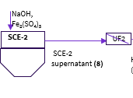
SCE -2 (Jar Tests)
FeSO₄ (High sludge volume)
Fe₂(SO₄)₃ (Lower sludge volume)
Notes:
-Experimental Results, Model Data, Learnings (The bulk of the presentation)

Slide 19
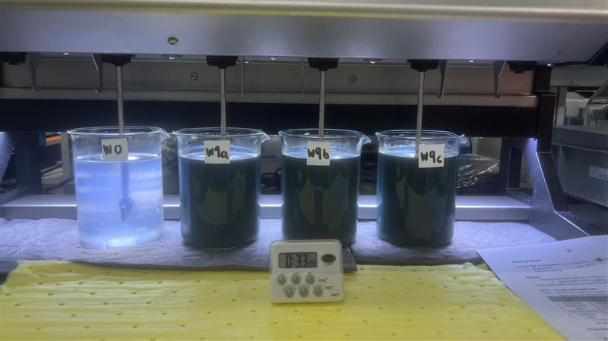
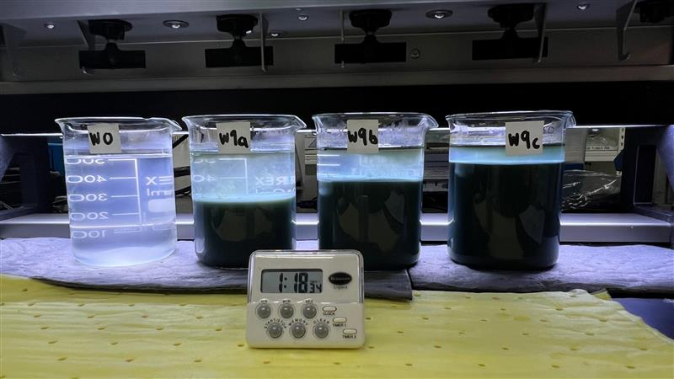
SCE-2–FeSO4
After polymer addition
After 30-min settling
FeSO4 is effective in silica removal, but the amount of sludge volume is high!

Slide 20
SCE-2 – FeSO4
 | 1) SCE-2 Feed | FeSO4* 2175 mg/L | 2) FeSO4 2,720mg/L | 3) FeSO4 3,260mg/L | 4) FeSO4 4,350mg/L
pH | 8.07 | 8.49 | 8.19 | 8.04 | 7.99
Total Silica, mg/L | 340 | 75.1 | 21.8 | 26.3 | 24.6
Dissolved Silica, mg/L | 186 | 82.7 | 16.6 | 22.2 | 13.7
Conductivity, μS/cm | 68,300 | 62,500 | 68,400 | 68,400 | 68,500
TDS, mg/L | 32410 | 24720 | 36130 | 37480 | 39180
Na, mg/L | 23,184 | 21710 | 29,351 | 28,080 | 25,889
Fe, mg/L | 2.04 | 35.1 | 53.1 | 78.8 | 60.3
Cl, mg/L | 2,253 | 2977 | 2,213 | 2,180 | 2,184
SO4, mg/L | 2,548 | 3925 | 5,738 | 6,657 | 7,744
W, mg/L | 131 | xx | 123 | 109 | 60
Based on design limit of (≤30 mg/L silica for SCE-2); 2720 mg/L FeSO₄ could be chosen.
Tackling Fe carryover in downstream processes? => (Maintain supernatant pH> 8.8, filter through CF/UF to bring down Fe levels)
How about ‘W’ removal?
Its removal rate is 50% with higher FeSO₄ dosage, but not practical due to high sludge volume.
*Note:- This test was performed for a similar water source in a separate experiment.
Notes:
Include 1 lower result - included

Slide 21
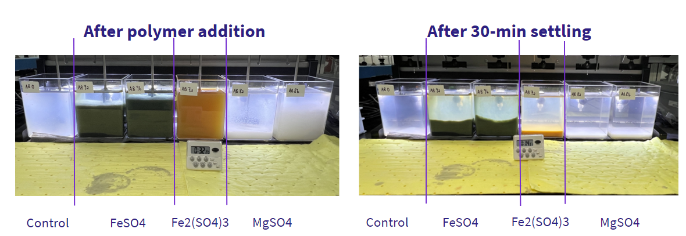
SCE-2 – FeSO4 vs Fe₂(SO₄)₃ vs MgSO4

Slide 22
SCE-2 – FeSO4, vs Fe₂(SO₄)₃ vs MgSO4
 | SCE-2 Feed | FeSO₄ 2,175mg/L | FeSO₄ 2,720 mg/L | Fe₂(SO₄)₃ 3,580mg/L | MgSO₄ 5,940 mg/L | MgSO₄ 9,905 mg/L
pH | 8.36​ | 8.9​ | 8.93​ | 9.62​ | 11.64​ | 11.84​
Total Silica, mg/L | ~240 | 25.5​ | 23.3​ | 38.5​ | 278​ | 255​
Dissolved Silica, mg/L | ~70 | 20.9​ | 17.3​ | 30.3​ | 250​ | 214​
Conductivity, μS/cm | 63,500​ | 63,800​ | 64,000​ | 62,000​ | 59,600​ | 54,000​
TDS, mg/L | 53,360​ | 55,200​ | 54,510​ | 47,720 | 41,600 | 44,370
Na, mg/L | 24,450​ | 20,480​ | 22,490​ | 18,870​ | 20,430​ | 20,500​
Fe, mg/L | 3.91​ | 24.2​ | 30​ | 8.46​ | <1​ | <1​
Cl, mg/L | 2,189​ | 2,509​ | 2,067​ | 2,551​ | 3,282​ | 2,279​
SO4, mg/L | 2,594​ | 4,567​ | 4,420​ | 4,205​ | 8,934​ | 10,804​
W, mg/L | 148 | 150 | 140 | 142 | 147 | 141
FeSO4 is effective in silica removal, but the amount of sludge volume is high!
Based on design limit of (≤30 mg/L silica for SCE-2); Fe₂(SO₄)₃ could be the next best option (@ pH >9.3) for effective silica removal.
For Fe carryover, use UF2 to filter before sending the stream to CFRO.
Tungsten removal is not achievable during the jar test.

Slide 23
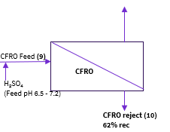
CFRO
Notes:
-Experimental Results, Model Data, Learnings (The bulk of the presentation)

Slide 24
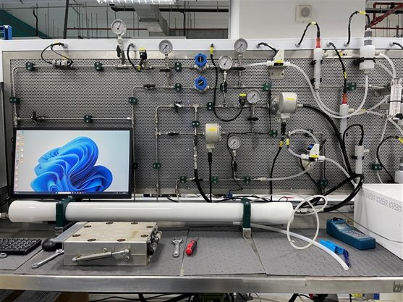
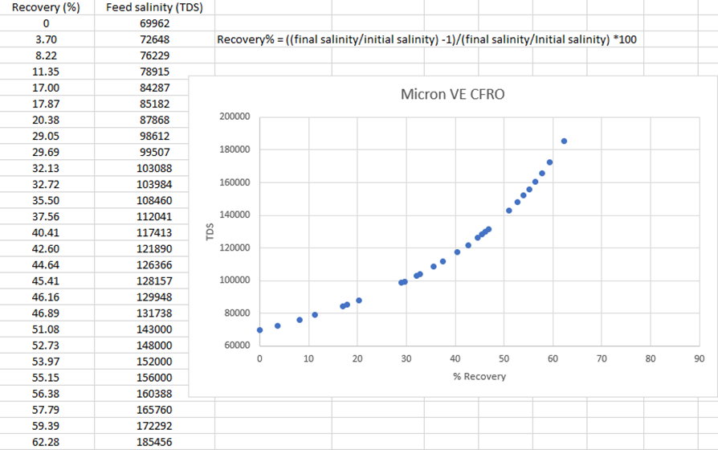
Experimental Set-Up
RO reject is treated via SCE-2→ UF → pH adj (6.5-7.2 range for better ammonia rejection) and fed into CFRO for brine concentration.
Custom, proprietary membranes were employed in the CFRO module.
Objective: Further concentration of RO reject to ~180,000 mg/L TDS

Slide 25
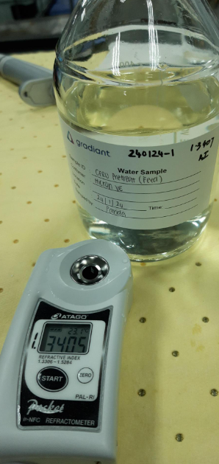
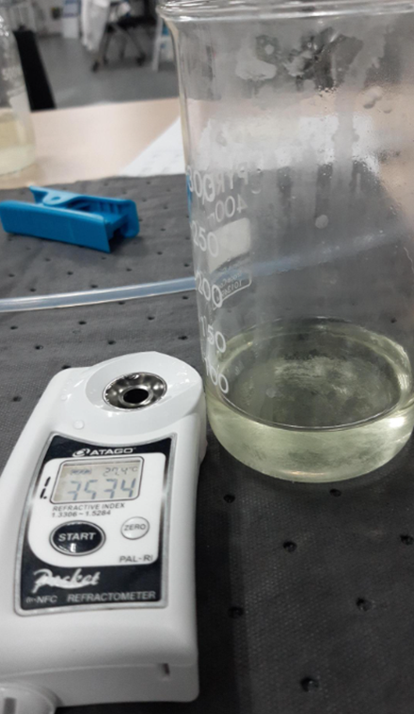
Analysis results
Parameter | CFRO feed | CFRO reject (~ 62% recovery)
pH | 7.19 | 8.23
TDS, mg/L | 64520 | 169440
SiO₂ (mg/L) | 159 | 269.5
Na (mg/L) | 23560 | 61720
F (mg/L) | 16691 | 24722
Cl (mg/L) | 2274 | 11284
PO₄ (mg/L) | 585 | 3193
SO₄ (mg/L) | 7263 | 30152
NO₃ (mg/L) | 9637 | 24761
NH₄ (mg/L) | 472.2 | 5,580
Reject RI ~ 1.3534 ~ 169,440 ppm TDS
Final recovery based on TDS ~ ((169440/64540)-1)/(169440/64520) ~ 61.9%
*Note: CFRO feed silica is high, to optimize silica removal (using Jar tests)
Feed RI ~ 1.3405 ~ 64,520 ppm TDS
Notes:
Future works include optimizing silica removal

Slide 26
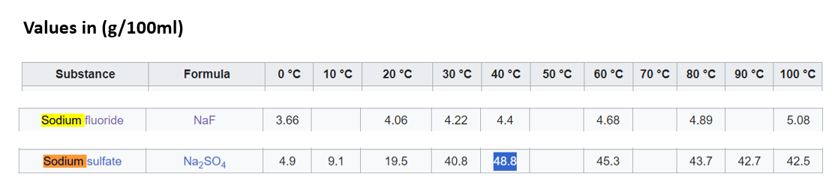
Bar charts
Note: Salt solubility in water at 30⁰ C
Salt solubility in water at 10⁰ C
Na, F and NO3 are the main constituents in RO2 feed.
In CFRO feed, excess sulphate was added to match design (hence sulphate% has increased).
Notes:
This bar chart shows %of ions against total ion composition, not the concentration in %.
Most of them add upto 100%

Slide 27
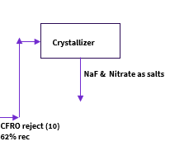
Crystallizer
Notes:
-Experimental Results, Model Data, Learnings (The bulk of the presentation)

Slide 28
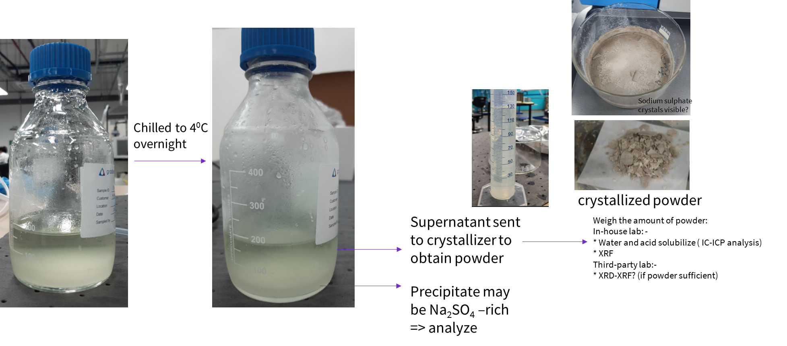
Procedure
Chilling – to precipitate Na₂SO₄ cooling crystallization
CFRO reject

Slide 29
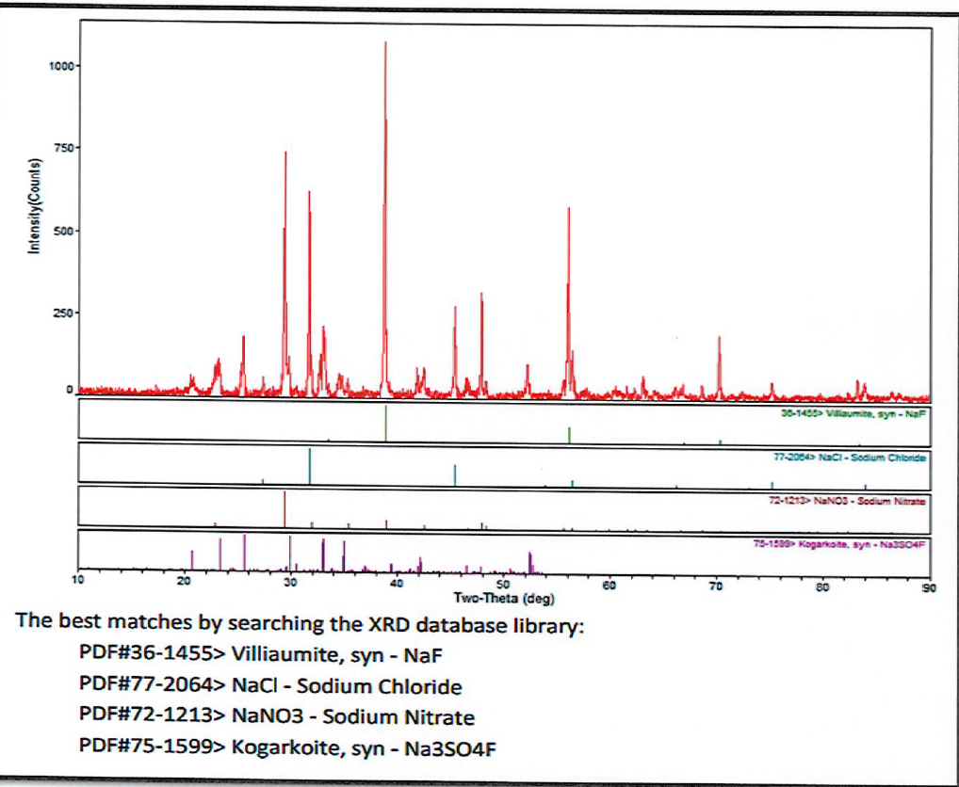
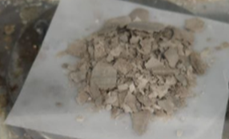
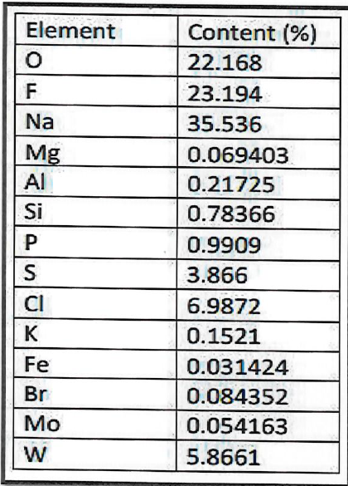
Crystallizer salt composition
XRD-XRF analysis
XRF
IC-ICP analysis
Main constituents are:- Na, F, SO₄, NO₃
For separation of fluoride salts from sulphate, Nanofiltration could be used.
Note: The detectable element range of XRF starts from element F; for XRD is from element B, hence NO3 ion visible in XRD does not show up as final “N%” in XRF.
Notes:
Better name == crystallizer salt composition

Slide 30
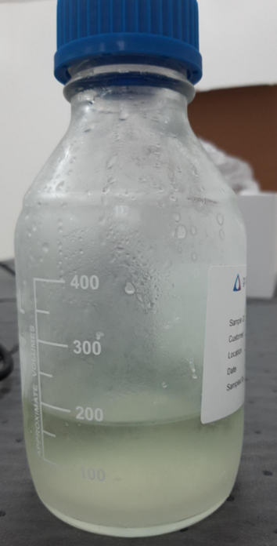
CFRO Precipitate Composition (Sodium Sulphate rich?)
IC-ICP analysis
This precipitate was formed even before chilling, probably due to NaF precipitation.
Precipitate is Fluoride- and tungsten-rich, instead of sulphate-rich! (Perhaps, chilling could have helped to precipitate out some amount of sulphate, but most of it remained in the supernatant!)
Since this precipitate is fluoride-rich, this fraction also could be sent to the crystallizer directly to obtain NaF powder.
Any concerns over W-in the final powder?
Notes:
Take out the co-ion effect slide

Slide 31
Crystallizer Step – Future works
CFRO rej precipitate
CFRO reject (10)
62% rec
F⁻ and NO₃⁻ rich permeate
CFRO Feed (9)
Nanofiltration
CFRO
Crystallizer
SO₄²⁻ rich reject
NaF & Nitrate
For selective removal of NaF from other salts, CFRO reject (supernatant) could be post-treated using NF, to remove sulphate ions in the NF reject.
NF permeate (with higher concentration of NaF and NaNO₃) could be crystallized further!
CFRO rej precipitate (rich in NaF and tungstate) in slurry form could be sent to crystallizer directly!
Notes:
Future Works

